Slide 1
INTRODUCTION TO
ALGORITHMS
FOURTH EDITION

Slide 2
LECTURE NOTES FOR CHAPTER 12
Binary Search Trees

Slide 3
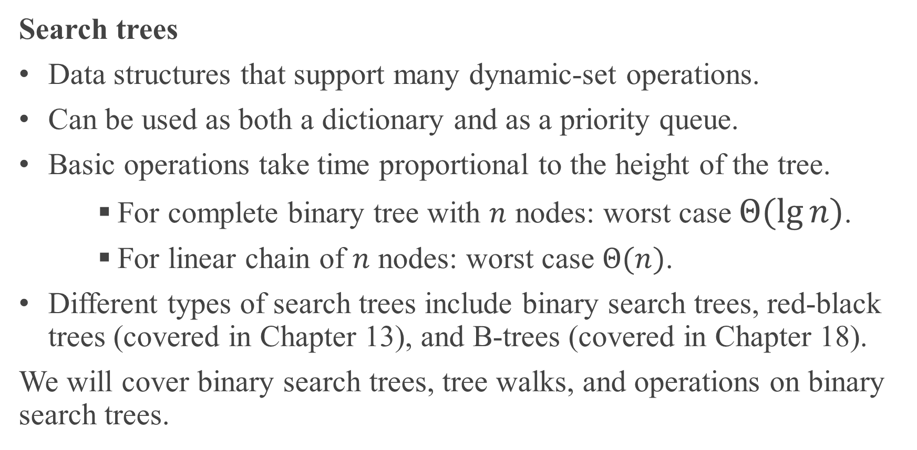
CHAPTER 12 OVERVIEW
Search trees
Data structures that support many dynamic-set operations.
Can be used as both a dictionary and as a priority queue.
Basic operations take time proportional to the height of the tree.
For complete binary tree with $n$ nodes: worst case $Θ(\lg{n})$.
For linear chain of $n$ nodes: worst case $Θ(n)$.
Different types of search trees include binary search trees, red-black trees (covered in Chapter 13), and B-trees (covered in Chapter 18).
We will cover binary search trees, tree walks, and operations on binary search trees.

Slide 4
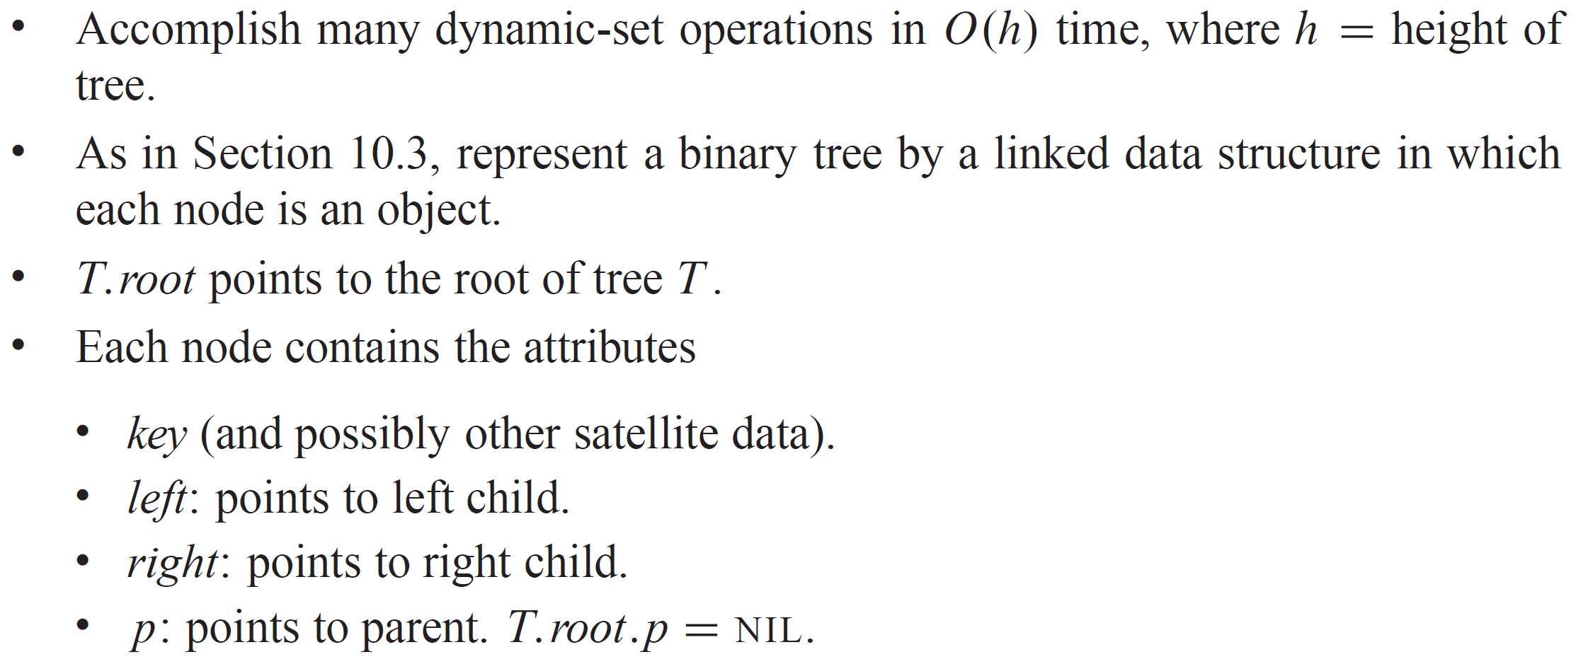
BINARY SEARCH TREES
Binary search trees are an important data structure for dynamic sets.

Slide 5
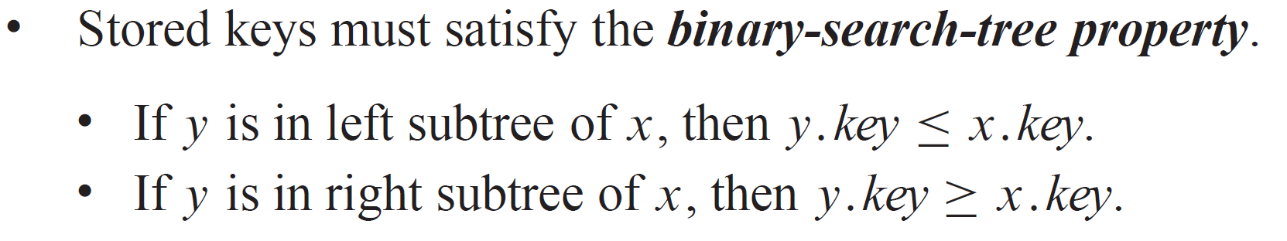
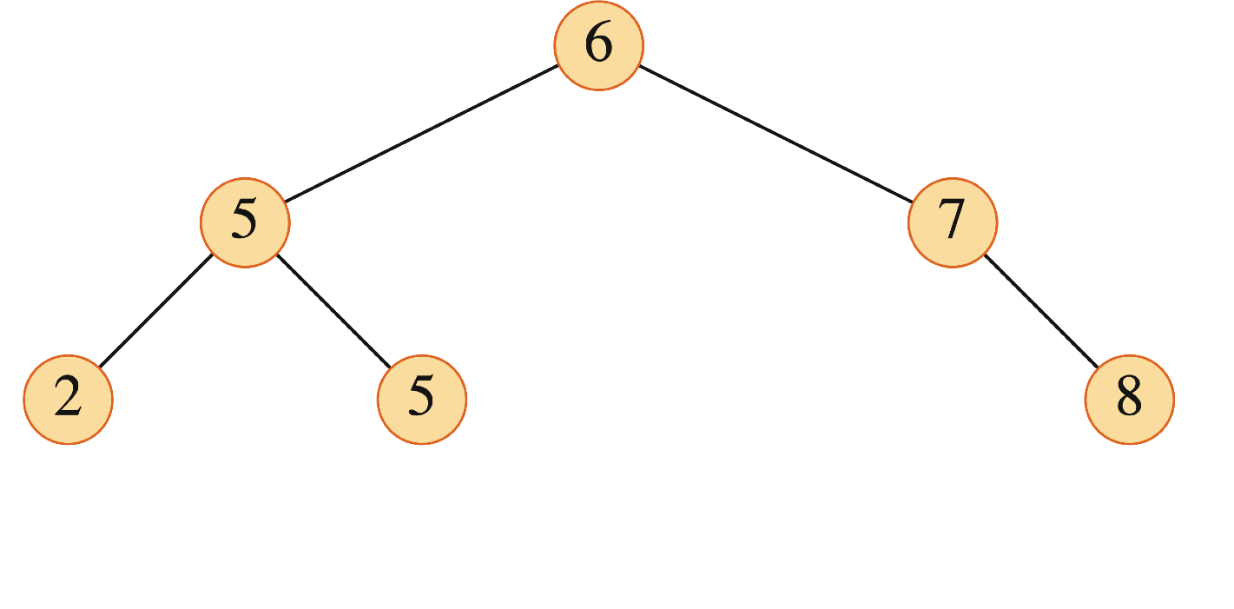
BINARY SEARCH TREES (continued)
The binary-search-tree property allows us to print keys in a binary search tree in order, recursively, using an algorithm called an inorder tree walk. Elements are printed in monotonically increasing order.

Slide 6
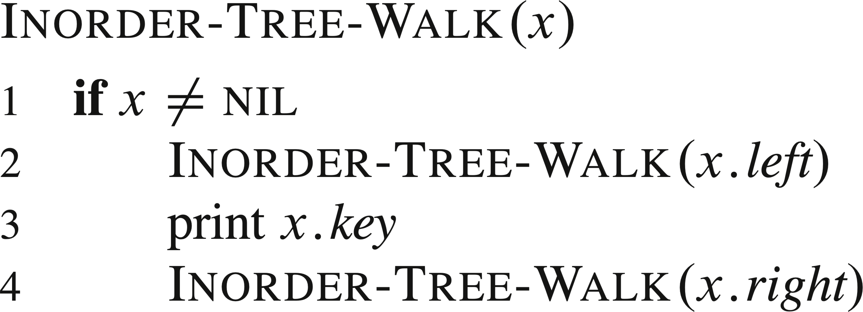

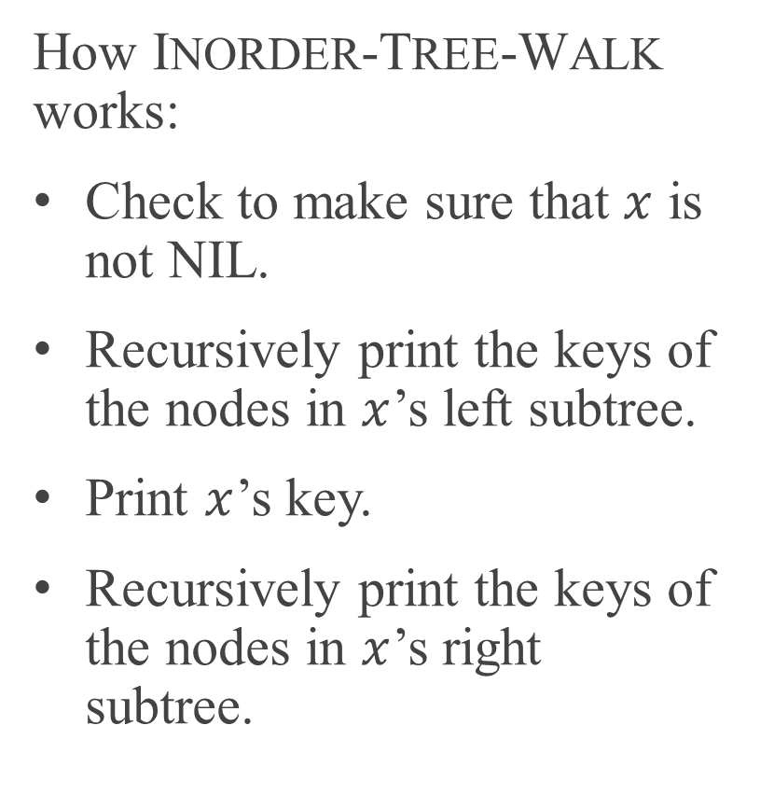
BINARY SEARCH TREES (continued)
How INORDER-TREE-WALK works:
Check to make sure that $x$ is not NIL.
Recursively print the keys of the nodes in $x$’s left subtree.
Print $x$’s key.
Recursively print the keys of the nodes in $x$’s right subtree.
Time
Intuitively, the walk takes $Θ(n)$ time.

Slide 7
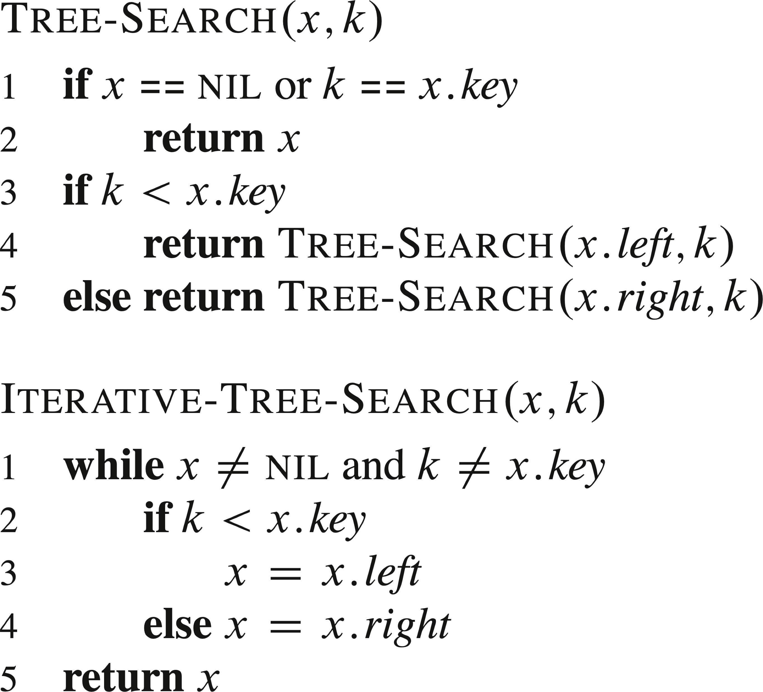
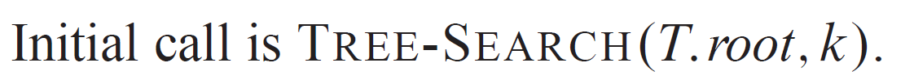
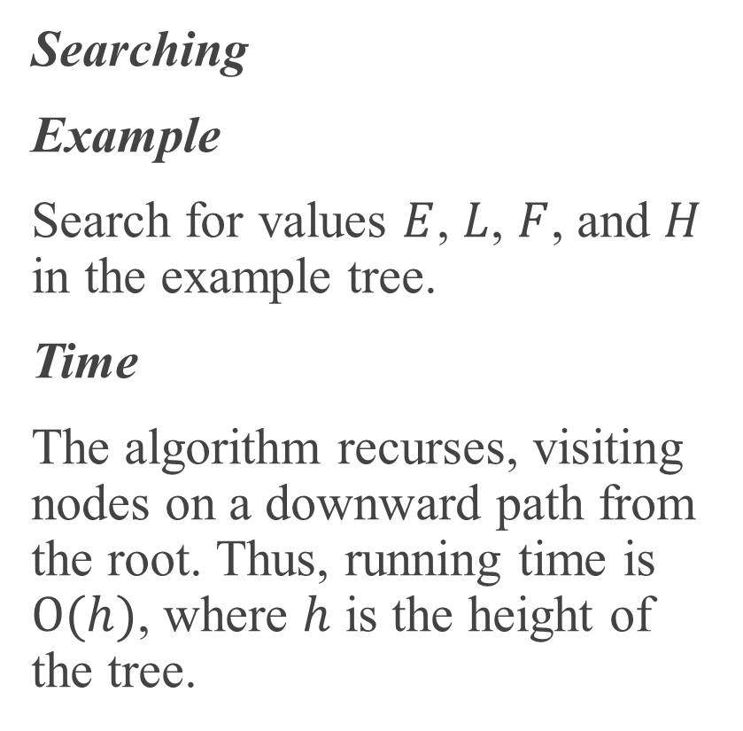
QUERYING A BINARY SEARCH TREE
Searching
Example
Search for values $E$, $L$, $F$, and $H$ in the example tree.
Time
The algorithm recurses, visiting nodes on a downward path from the root. Thus, running time is $O(h)$, where $h$ is the height of the tree.

Slide 8
QUERYING A BINARY SEARCH TREE
Iterative version
The iterative version unrolls the recursion into a while loop. It’s usually more efficient than the recursive version, since it avoids the overhead of recursive calls.

Slide 9
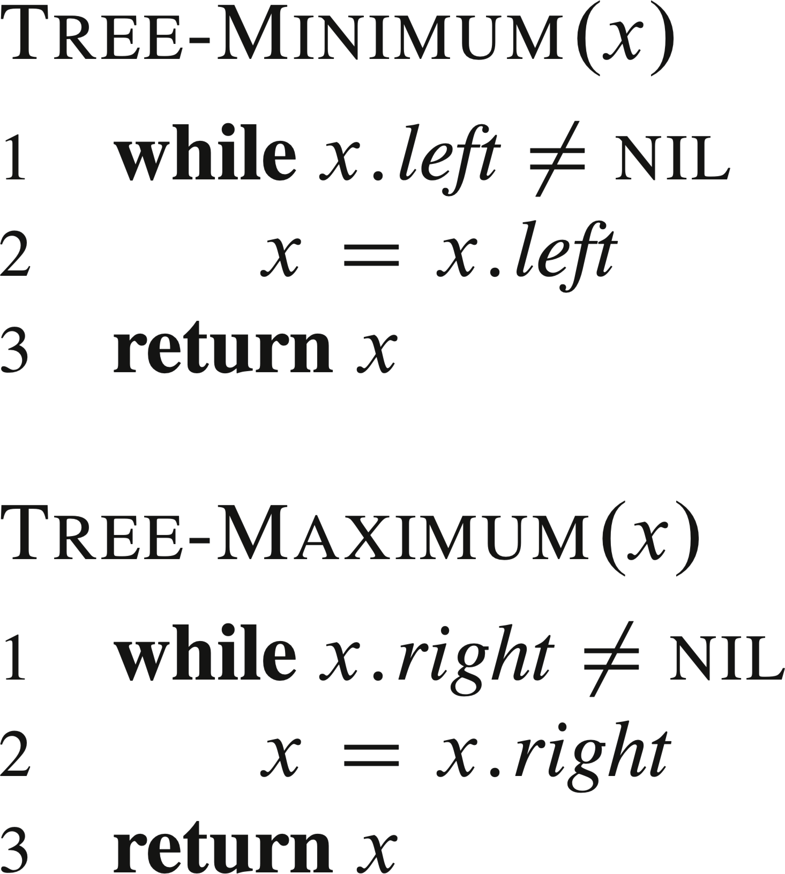
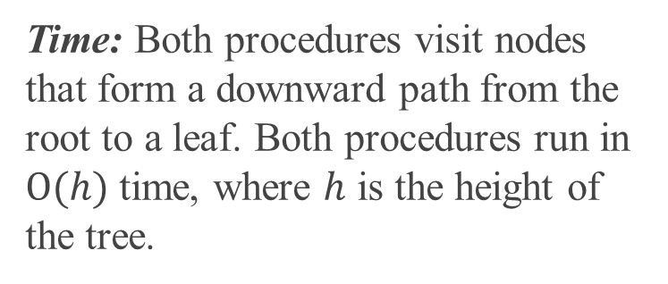
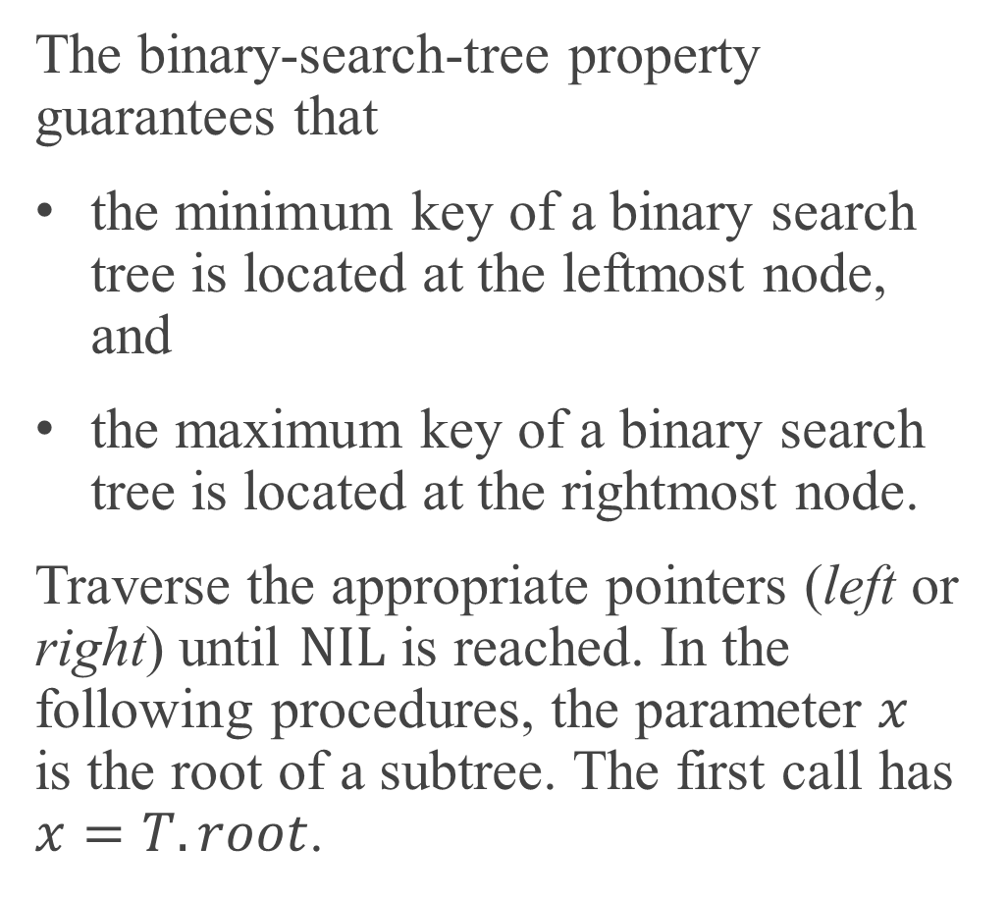
MINIMUM AND MAXIMUM
The binary-search-tree property guarantees that
the minimum key of a binary search tree is located at the leftmost node, and
the maximum key of a binary search tree is located at the rightmost node.
Traverse the appropriate pointers (left or right) until $NIL$ is reached. In the following procedures, the parameter $x$ is the root of a subtree. The first call has $x=T.root$.
Time: Both procedures visit nodes that form a downward path from the root to a leaf. Both procedures run in $O(h)$ time, where $h$ is the height of the tree.

Slide 10
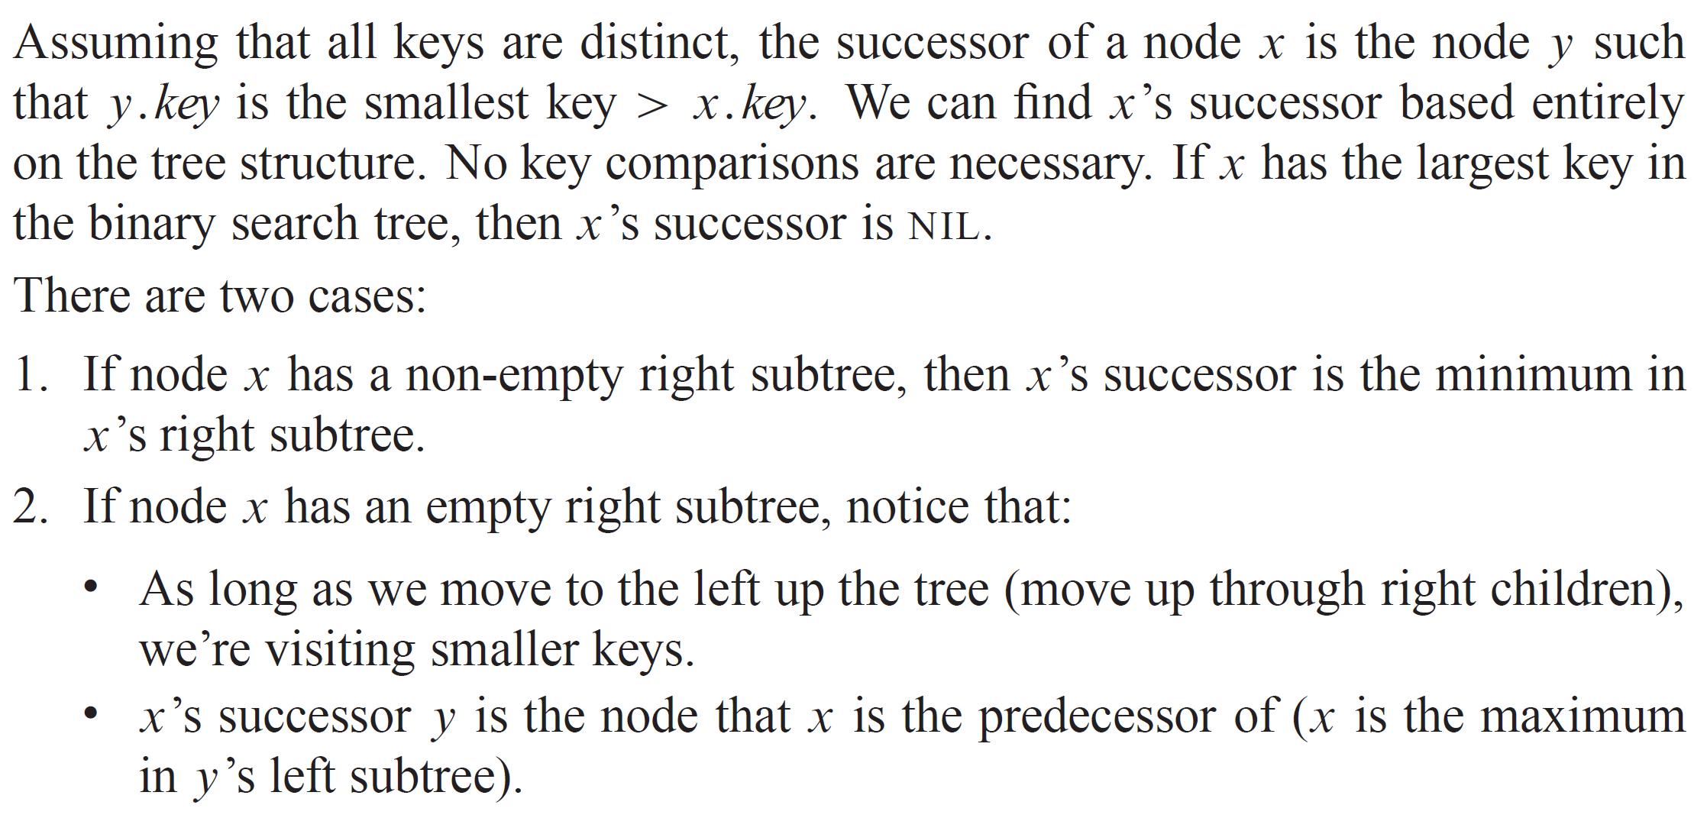
SUCCESSOR AND PREDECESSOR

Slide 11
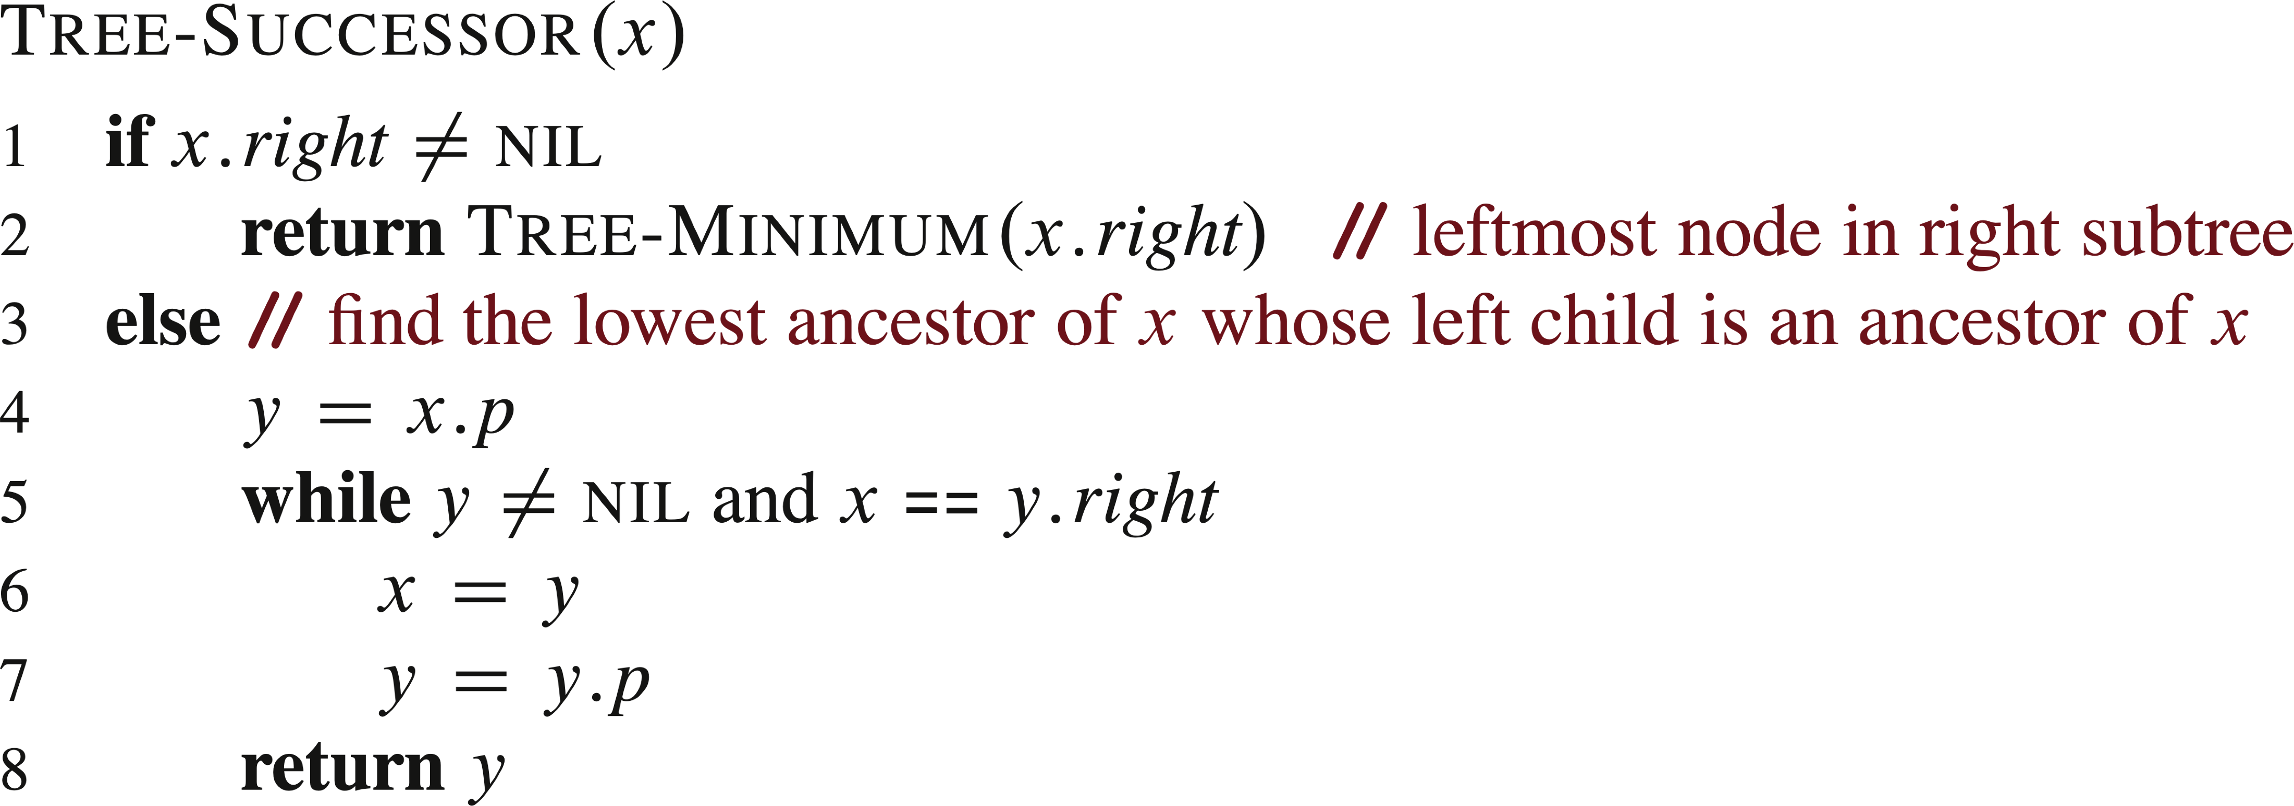
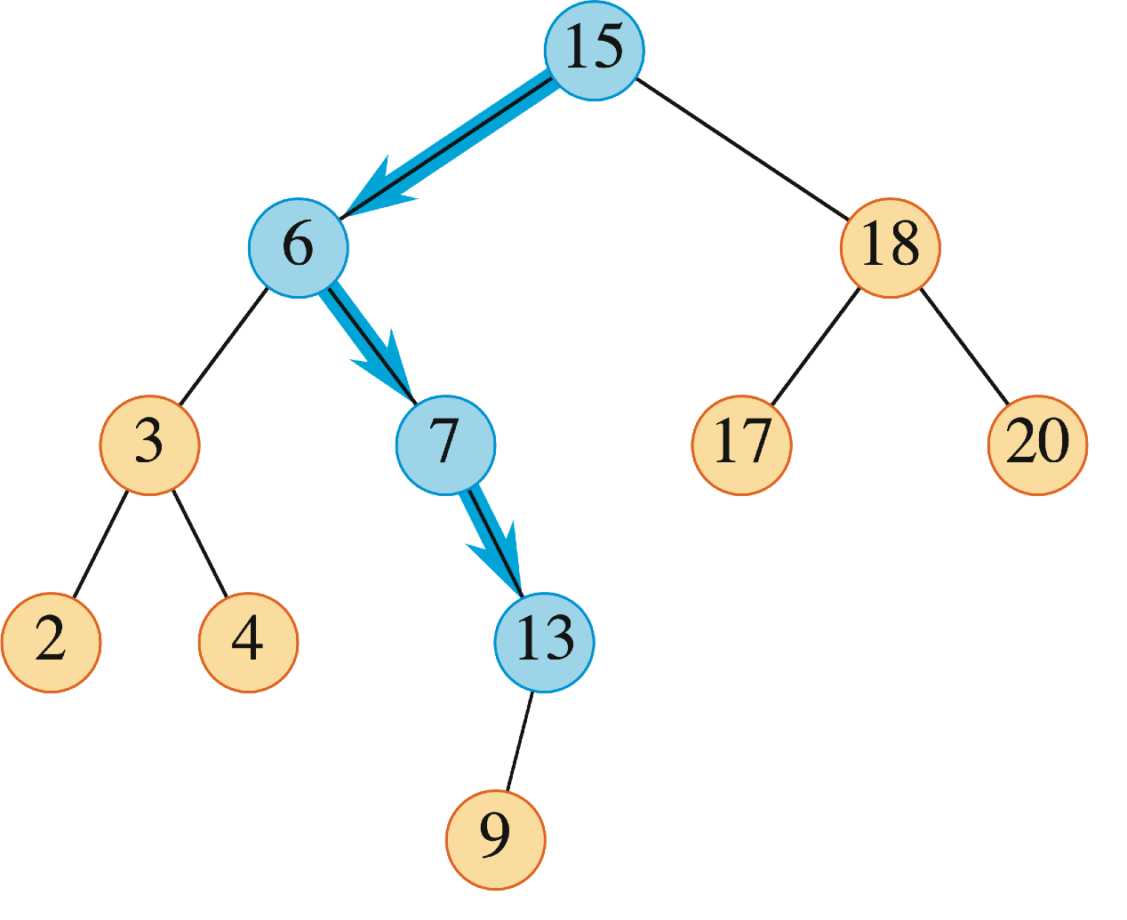
SUCCESSOR AND PREDECESSOR (continued)
TREE-PREDECESSOR is symmetric to TREE-SUCCESSOR.
Example
Find successor of 15, 6, and 4.

Slide 12
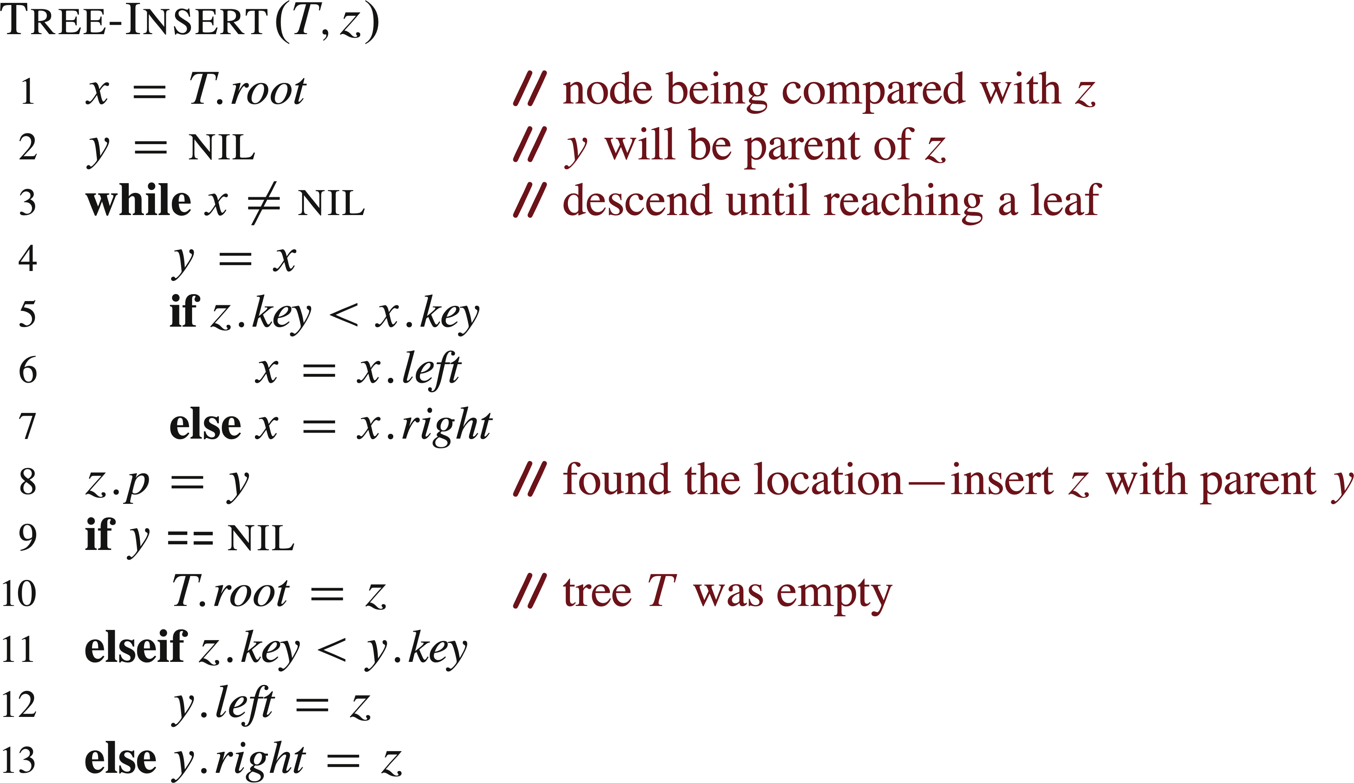
INSERTION

Slide 13
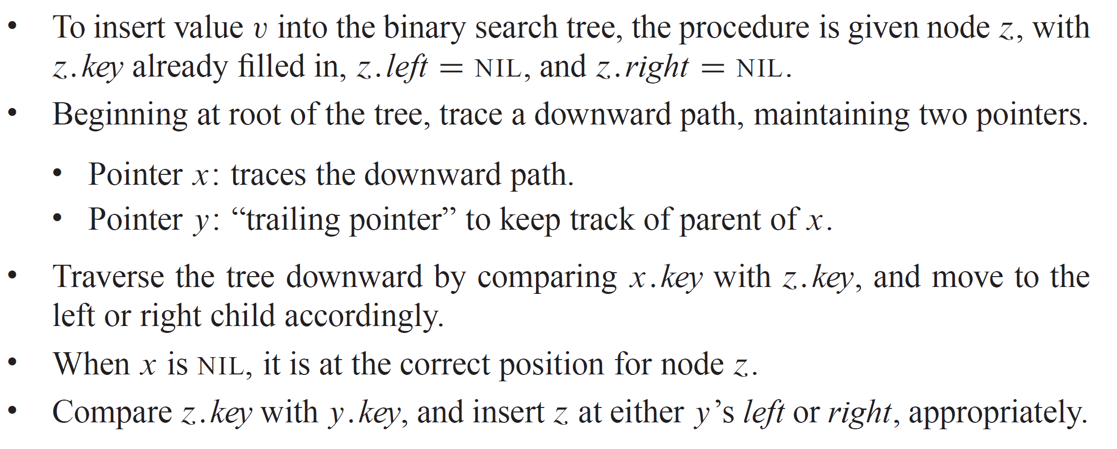
INSERTION ANALYSIS

Slide 14
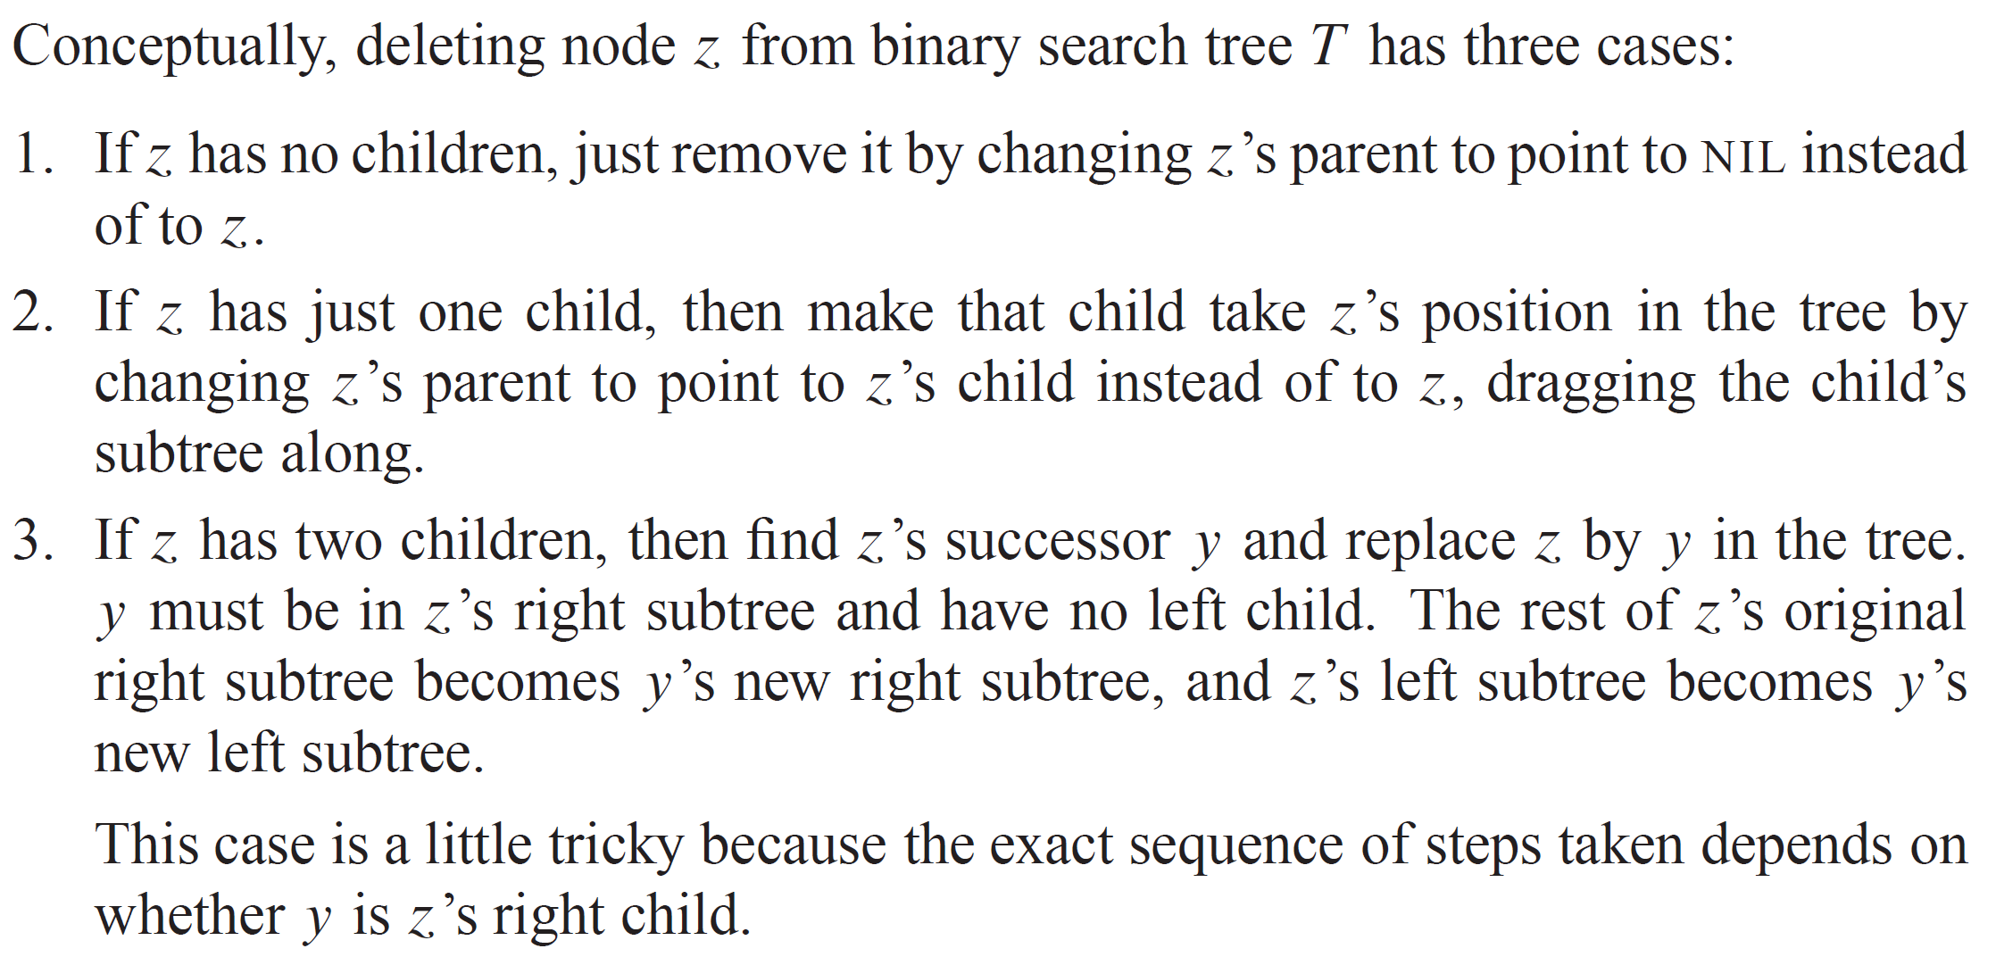
DELETION

Slide 15
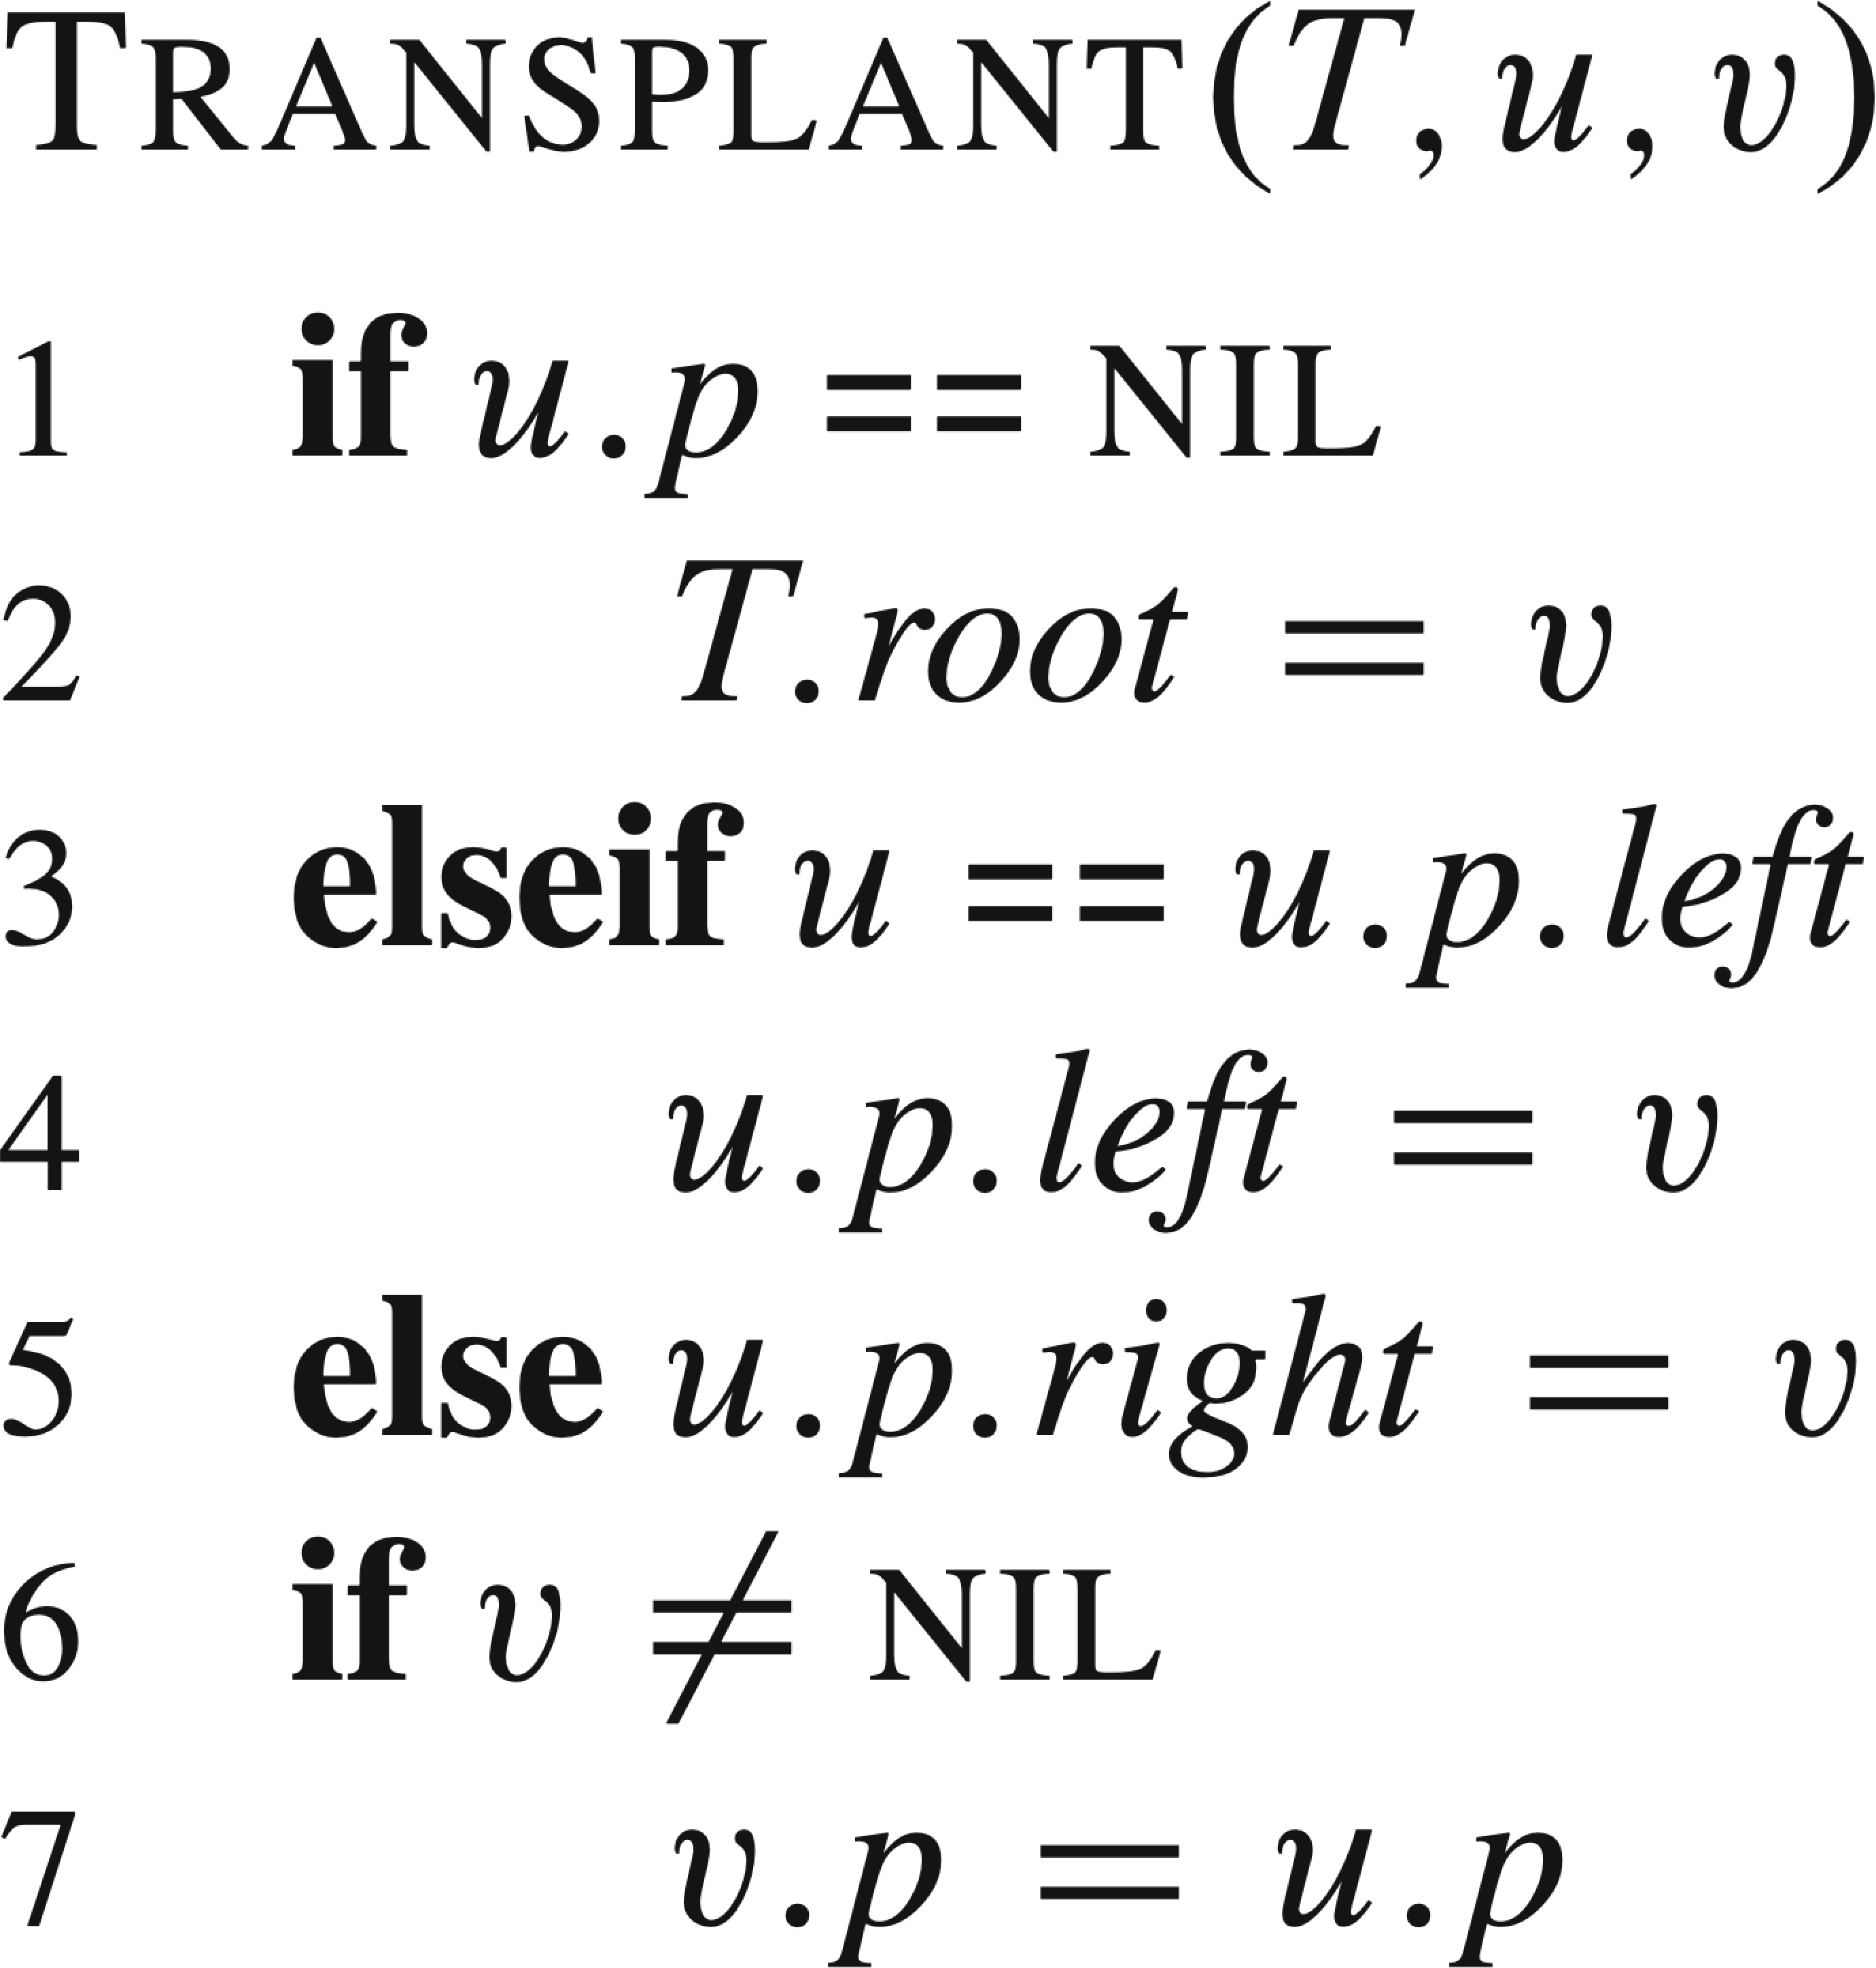
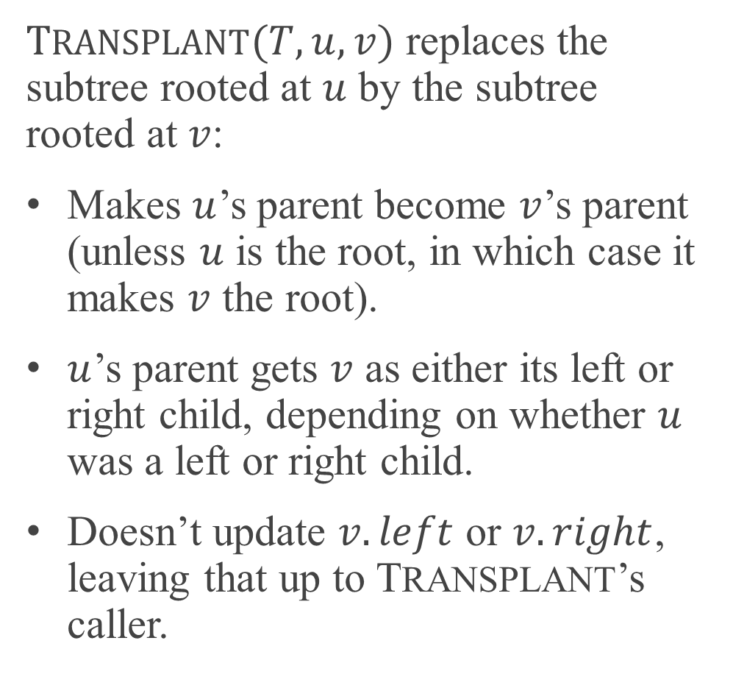
TRANSPLANT
$TRANSPLANT(T, u, v)$ replaces the subtree rooted at $u$ by the subtree rooted at $v$:
Makes $u$’s parent become $v$’s parent (unless $u$ is the root, in which case it makes $v$ the root).
$u$’s parent gets $v$ as either its left or right child, depending on whether $u$ was a left or right child.
Doesn’t update $v.left$ or $v.right$, leaving that up to TRANSPLANT’s caller.

Slide 16
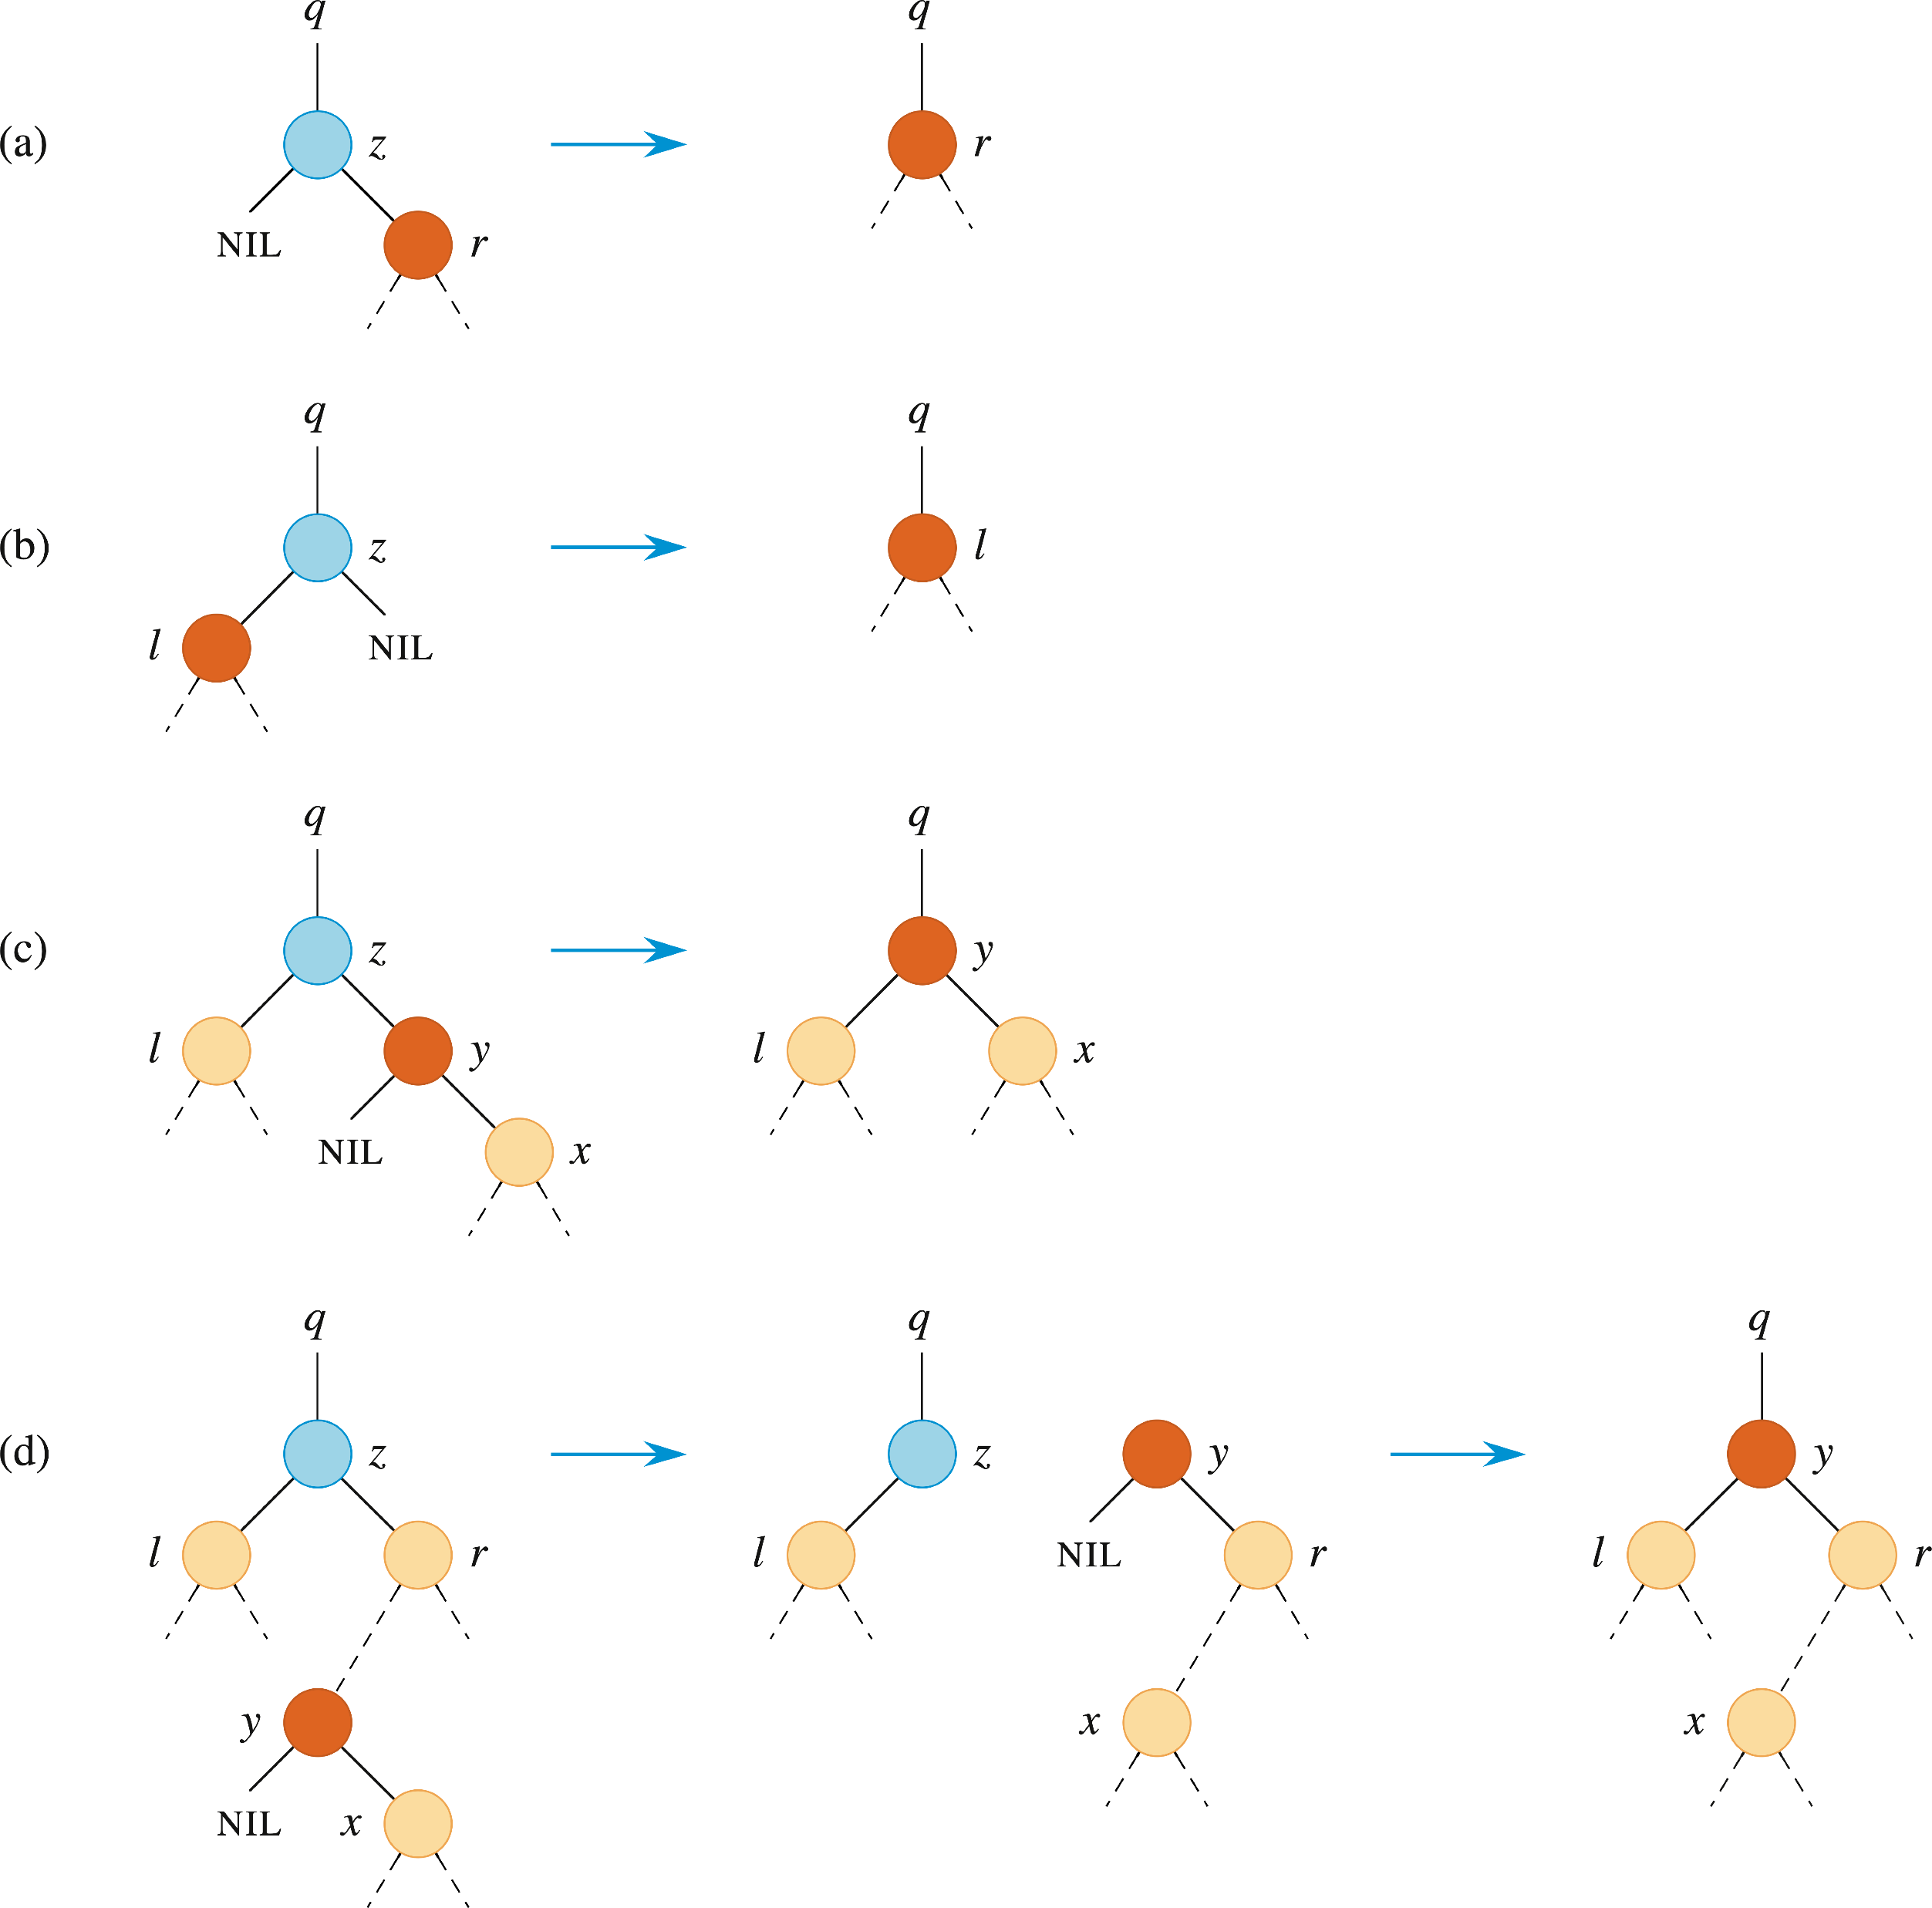

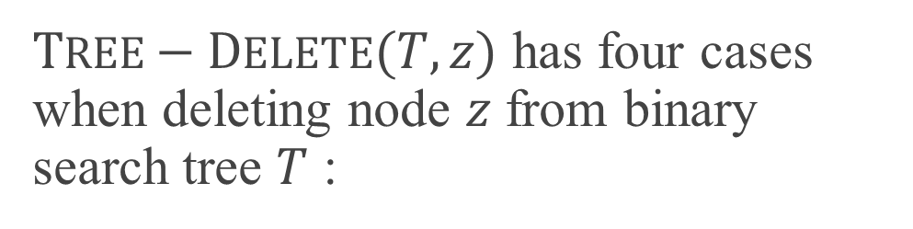
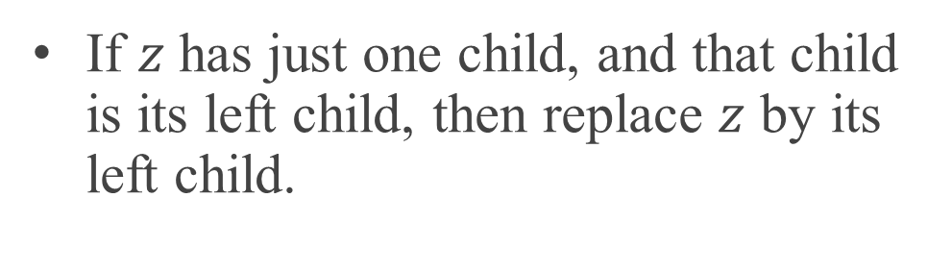
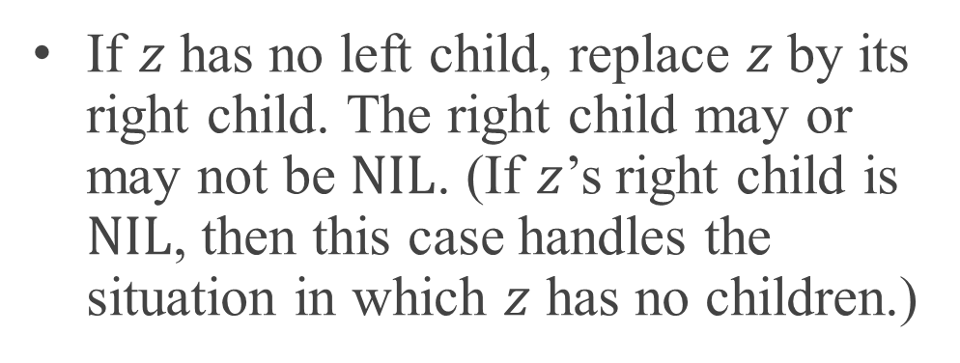
TREE-DELETE
$TREE−DELETE(T,z)$ has four cases when deleting node $z$ from binary search tree $T$ :
If $z$ has no left child, replace $z$ by its right child. The right child may or may not be $NIL$. (If $z$’s right child is $NIL$, then this case handles the situation in which $z$ has no children.)
If $z$ has just one child, and that child is its left child, then replace $z$ by its left child.

Slide 17
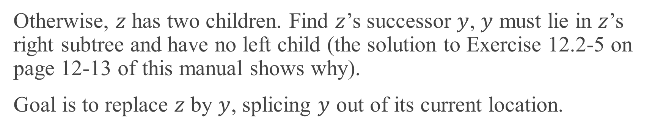
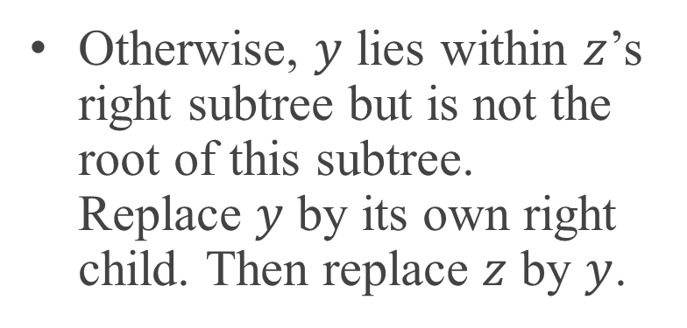
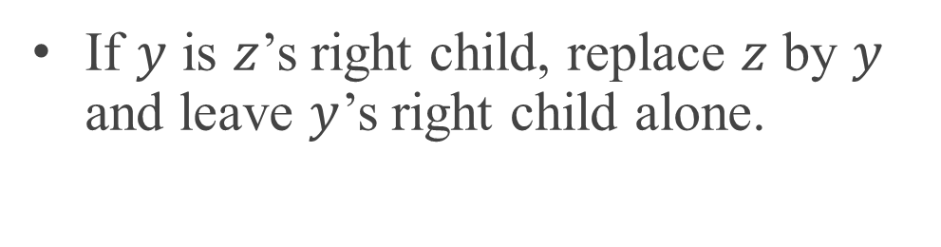
TREE-DELETE (continued)
Otherwise, $z$ has two children. Find $z$’s successor $y$, $y$ must lie in $z$’s right subtree and have no left child (the solution to Exercise 12.2-5 on page 12-13 of this manual shows why).
Goal is to replace $z$ by $y$, splicing $y$ out of its current location.
If $y$ is $z$’s right child, replace $z$ by $y$ and leave $y$’s right child alone.
Otherwise, $y$ lies within $z$’s right subtree but is not the root of this subtree. Replace $y$ by its own right child. Then replace $z$ by $y$.

Slide 18
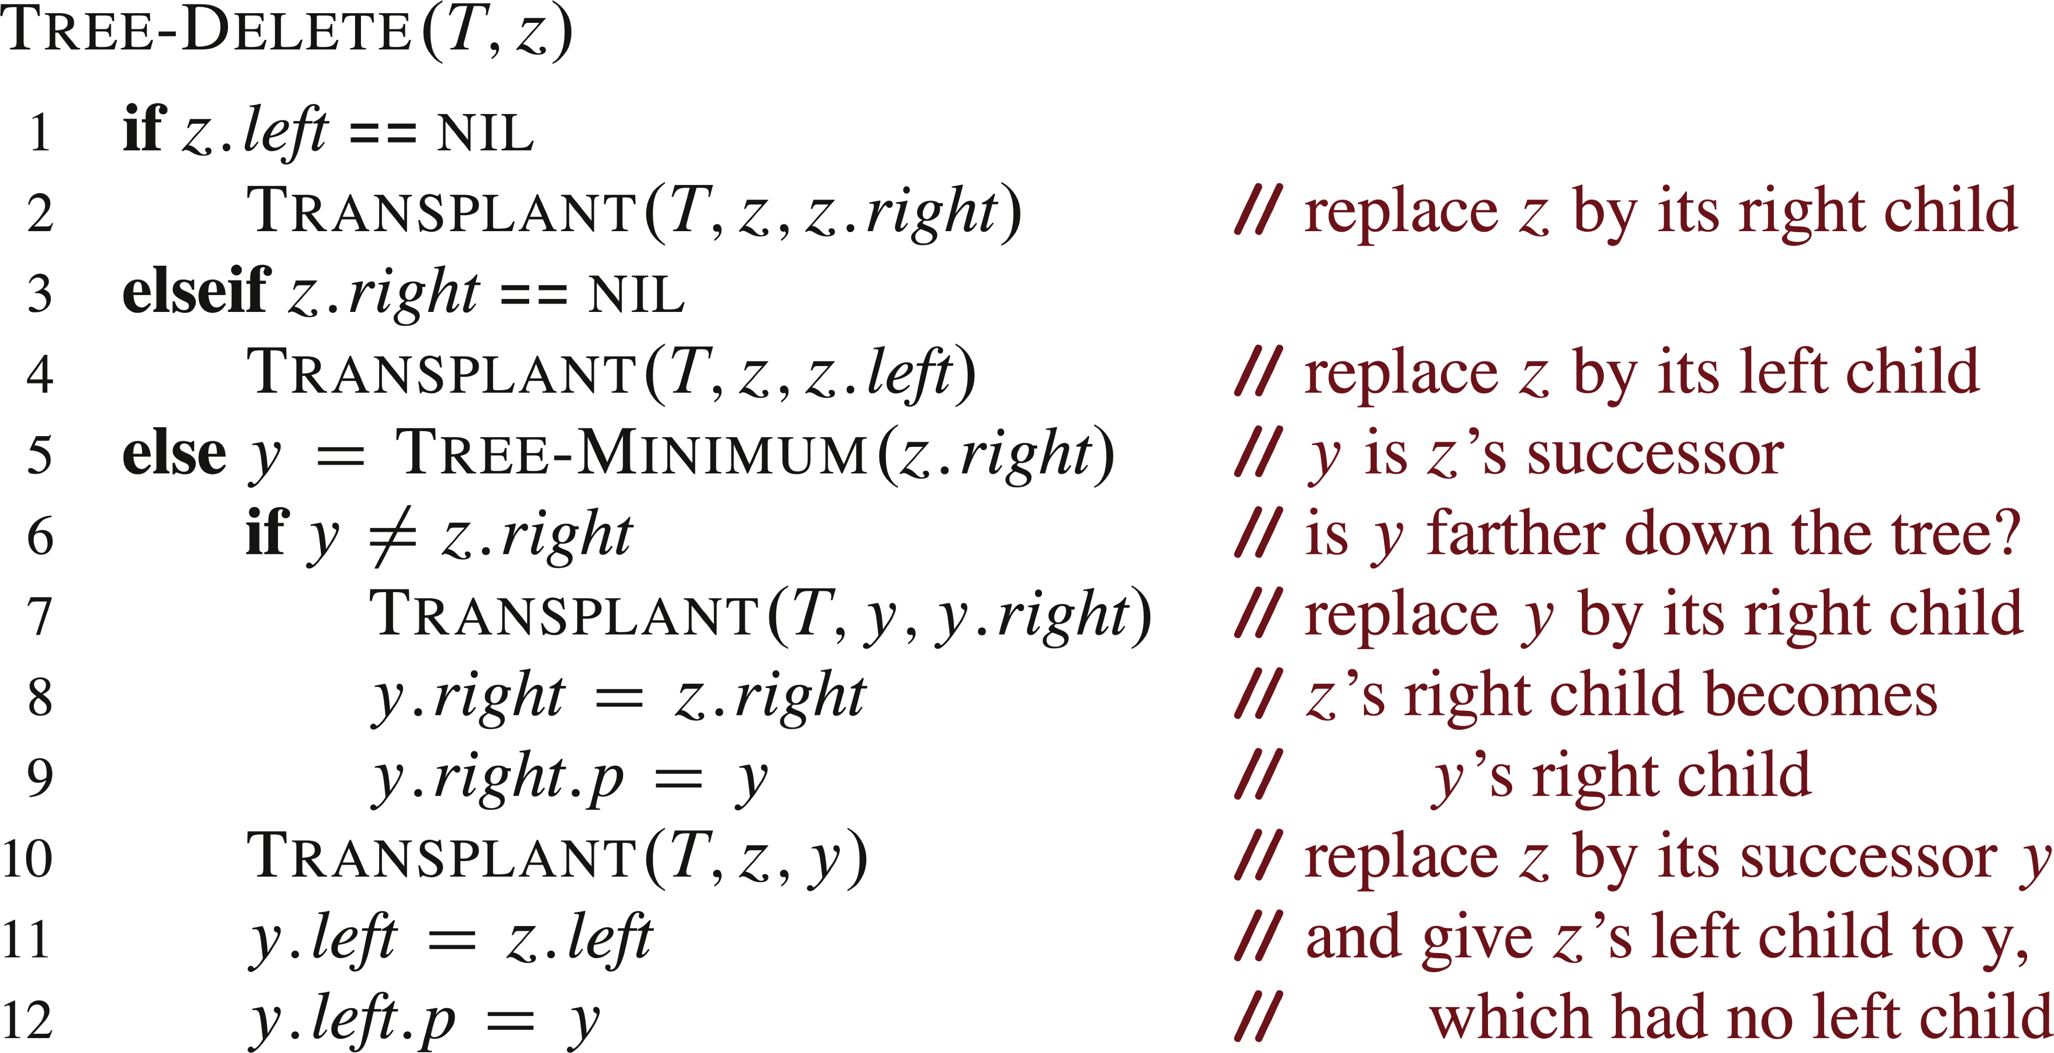

TREE-DELETE (continued)
Note that the last three lines execute when $z$ has two children, regardless of whether $y$ $y$ is $z$’s right child.

Slide 19
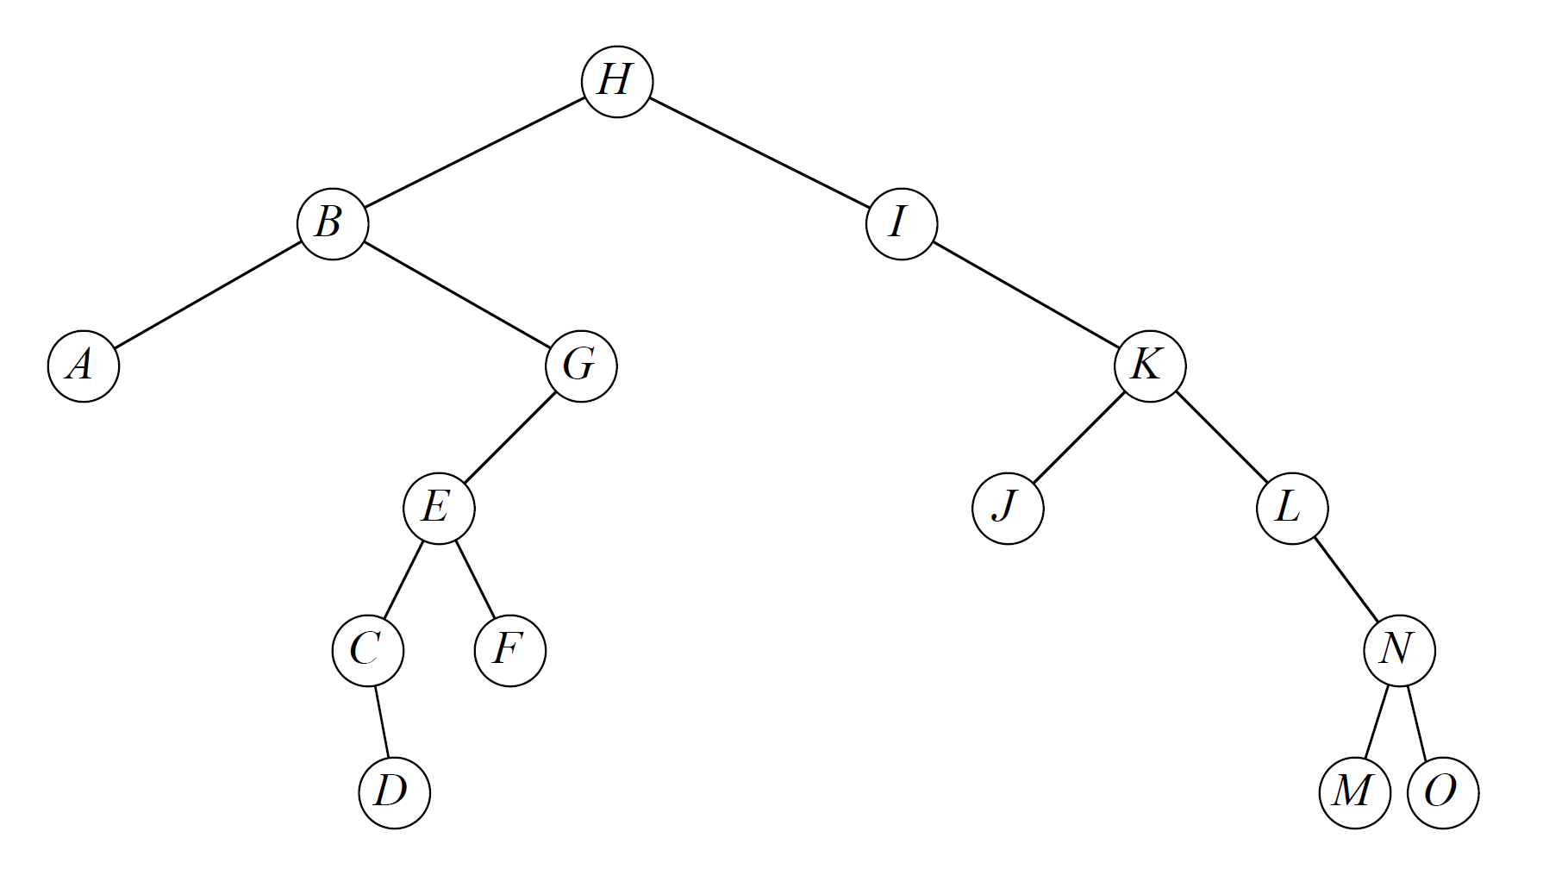
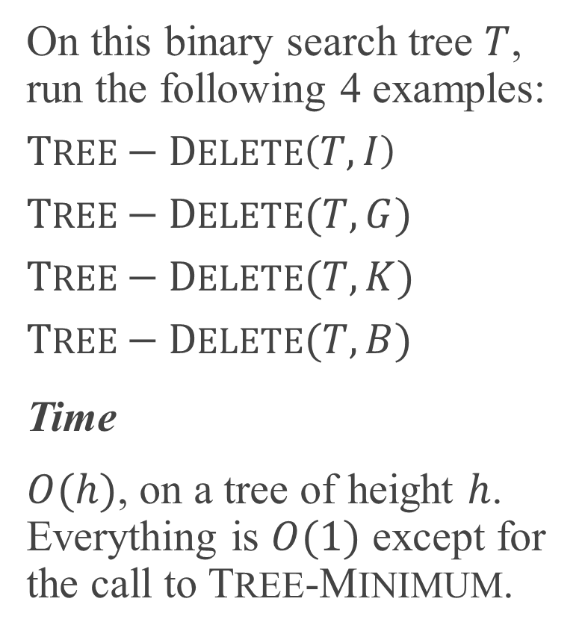
TREE-DELETE EXAMPLE
On this binary search tree $T$, run the following 4 examples:
$$TREE−DELETE\left(T,I\right)$$
$$TREE−DELETE(T,G)$$
$$TREE−DELETE(T,K)$$
$$TREE−DELETE(T,B)$$
Time
$O(h)$, on a tree of height $h$. Everything is $O(1)$ except for the call to TREE-MINIMUM.

Slide 20
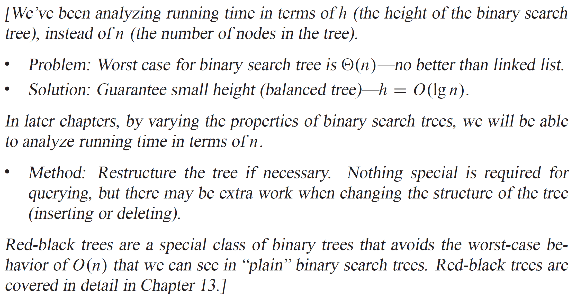
ANALYSIS

